Slide 1



Financing for regulatory independence:
A multi-jurisdictional perspective
Dr. Jennifer Chen
Principal, Global Power
Regulatory Assistance Project

Slide 2
Regulatory independence in multi-jurisdictional regions
Ability to make evidence-based rational decisions impartial from political & market pressures
  Ensure investor confidence needed for capital-intensive infrastructure, technology neutral competitive markets, consumer protection
Self-sufficient finance key to regulator capacity to promote these goals
Financial support to independent decision making can take on other dimensions as regulatory authorities participate in regional institutions
Consider the context of energy regulation split between state & regional / federal jurisdictions in the US
  Independent state public utility commissions oversee in-state infrastructure expansion and retail rates
  Regulation of interstate energy sales and infrastructure falls under federal authority

Slide 3
Independence at state, regional & federal
Federal Energy Regulatory Commission (FERC) as an independent agency has been less susceptible to political pressure compared to executive agencies
  Recent court decision will test that: Trump v. Slaughter -- president may fire commissioners of independent federal agencies without cause
Independence at regional/state levels could mitigate pressure
Regional Transmission Organizations (RTOs) have mandates for independent decision making
  RTOs are public utilities under the Federal Power Act (FPA)
    FPA Section 205: utility file tariffs that go into effect within 60 days unless FERC acts to find them to be unlawful
  RTOs conduct stakeholder processes to shape market rule and transmission planning proposals

Slide 4
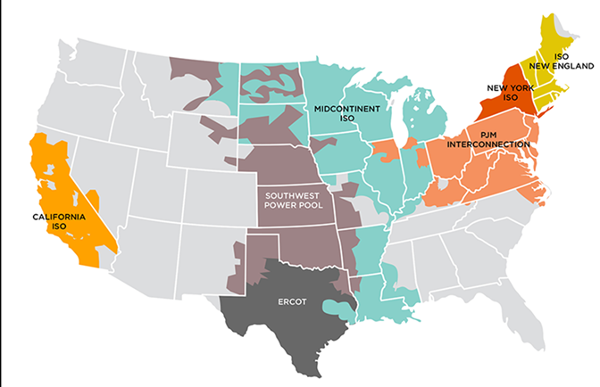
Independence of Regional Transmission Organizations
FERC Order 2000: RTOs must be financially & operationally independent
  RTOs, employees, non-stakeholder directors cannot have any financial interests in any market participants
  RTOs must have
    A decision-making process independent of market participant control
    Exclusive and independent authority to file changes to its transmission tariff under FPA section 205
FERC requires all RTOs to all have market monitors
  Most are independent external market monitors (IMMs)
  Can monitor the RTO and its market participants, identify market design flaws, and assess proposals and estimate cost/benefit of alternatives

Slide 5
Diversified revenue across decision-making layers
FERC: self-funded from regulated entities
Annual charges assessed on public utilities, gas pipelines, oil pipelines, hydroelectric projects proportional to size, usage, volume
Transaction-based charges for applications, petitions (rate approvals or declaratory orders), etc.
Budget: $520M (FY 2026)
Employs ~1,500 full-time staff
RTOs: revenue-neutral – fees cover operational, administrative, capital expenses
RTO tariffs fund IMMs, consumer advocate organizations, regional states committees participating in their stakeholder processes
Example: PJM
  Serves ~ 18% of US total electricity load
  Services that it transacts ~ $80B
Fees scale with the services members use: ~$380M (2025)
> 1,000 employees
IMM: funded by market participants related to usage, which includes energy delivered (MWh) ~$15M per year
Organization of PJM States: funded via rate scaling with the energy delivered ($0.0014 per MWh) ~$1M annually
Consumer Advocates of PJM States: similarly funded ($0.0007 per MWh) ~$500K per year

Slide 6
Leveraging independent regional institutions
RTOs & IMMs can:
  Identify market flaws, propose rule changes, model impacts, study alternatives, estimate costs and benefits
  Conduct training sessions, answer technical questions, incorporate stakeholder inputs on assumptions and scenarios in modeling
Important:
  Transparent stakeholder processes that enable state & public interest organizations to help shape decisions
  Funding state and consumer advocate organizations to participate in RTO processes -- they can perform studies and propose improvements
Studies and stakeholder perspectives can feed into FERC decision making, which is required to be based on record evidence

Slide 7
Regional institutions can supplement capacity but also require careful governance design
Benefits to resource sharing, but governance & stakeholder processes should facilitate decision making between regulators across states, especially when their energy policies conflict with each other’s or market forces
  Can include clarifying roles for different authorities and ensuring the decision-making process enables a subset of states to pay for what they need instead of allowing a lack of consensus to prevent action
FERC weighs a broader range of stakeholder comments submitted to its public decision-making record compared to RTOs
  Relying more on RTOs to shape rules elevates the importance of better incorporating a broader range of perspectives in decision making
Governance reform is a work in progress
  FERC’s proceeding seeking to improve PJM’s governance offers lessons applicable to other regions seeking to improve cross-border institutions

Slide 8
Thank you! jechen@raponline.org
www.raponline.org/experts/jennifer-chen/

